Slide 1

Codeword Generator
Client:
Dr. Charles Hoot
Team Members:
Anurag Kumar
Chaitanya Cherukuru
Naveen Kumar Nuggu
Ujjawal Kumar
Advisors:
Dr. Ajay Bandi
Dr. Denise Case
Team Scrutinizer

Slide 2
Functional Requirements
Instructor’s login | Student’s login
Signup and Login | Signup
Reset password with forgot password option | Login
View dashboard after successful login | Reset password with forgot password option
Add course by uploading students in course and view percentage of Codewords retrieved by students | View all the enrolled courses along with assigned codewords for respective courses
Create Codeword Set by uploading codewords and can view count of codewords in each Codeword set | Retrieve Codeword for particular course
Edit/Delete codewords in any codewordset | Use retrieved codewords to take surveys
Ujjawal Kumar
2

Slide 3









Tools And Technologies
Ujjawal Kumar
3

Slide 4






Tasks Accomplished(By midterm presentation)
Paper/electronic prototypes
UI Design
Database creation
Backend environment setup
Attribute modification
Connected frontend, backend & database
Ujjawal Kumar
4

Slide 5

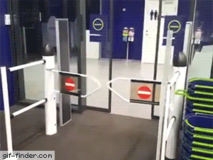







Tasks to Accomplish(Post midterm presentation)
Application deployment on heroku
Unit Testing & finding issues
Fixing the issues to get bug free application
Automation testing using Selenium
Ujjawal Kumar
5

Slide 6

Demonstration
Fig: E-R Design
Ujjawal Kumar
6

Slide 7
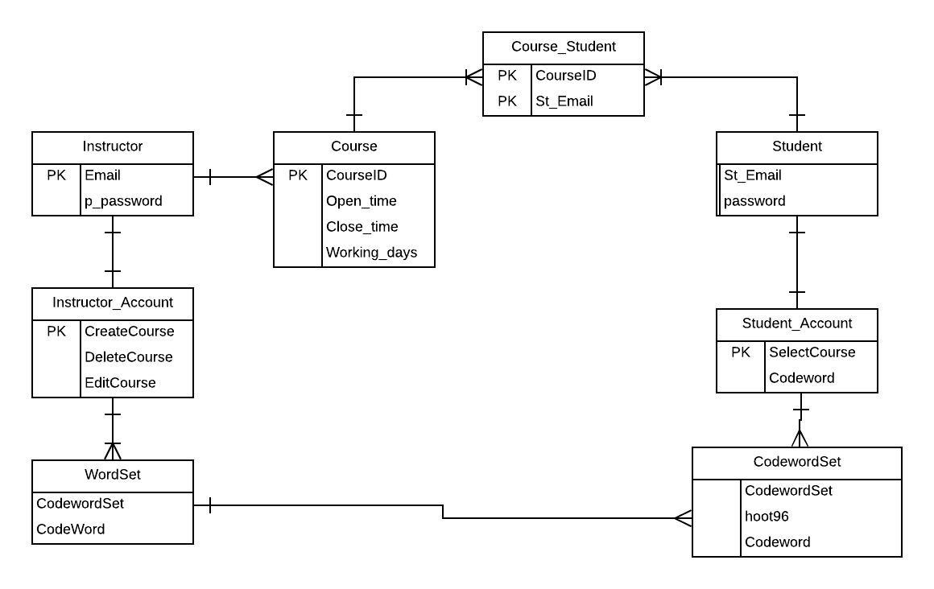
Entity-Relationship Design
Fig: E-R Design
Anurag Kumar
7

Slide 8
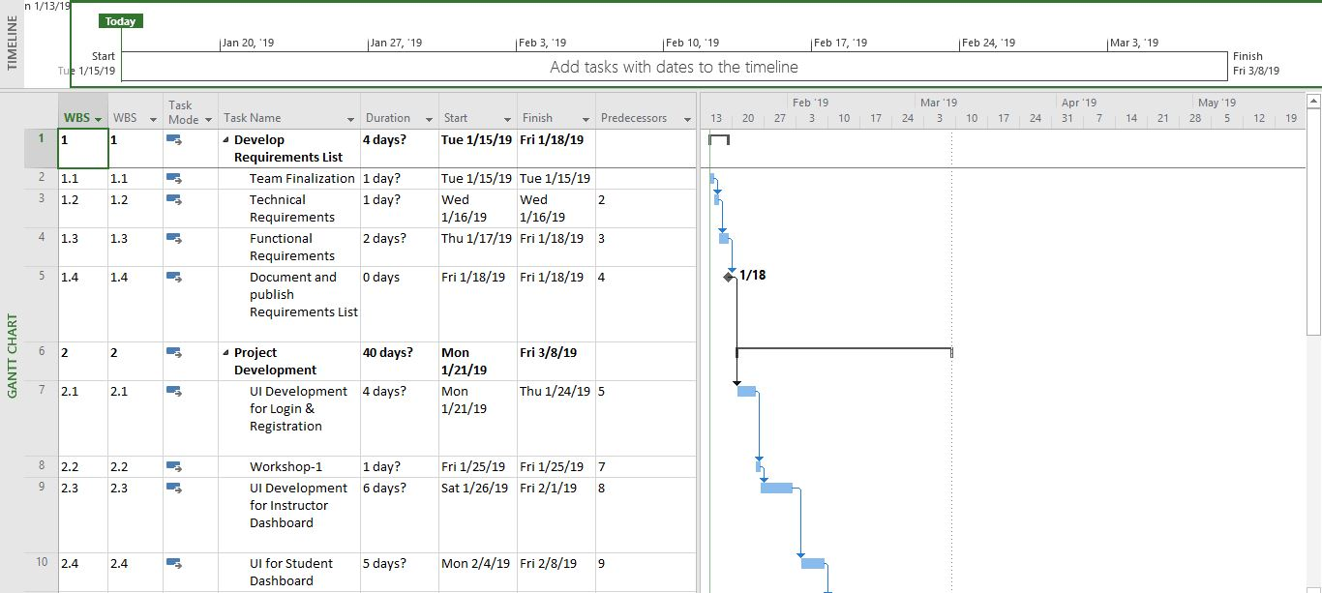
Gantt-Chart
Fig: Gantt-chart 1
Anurag Kumar
8

Slide 9
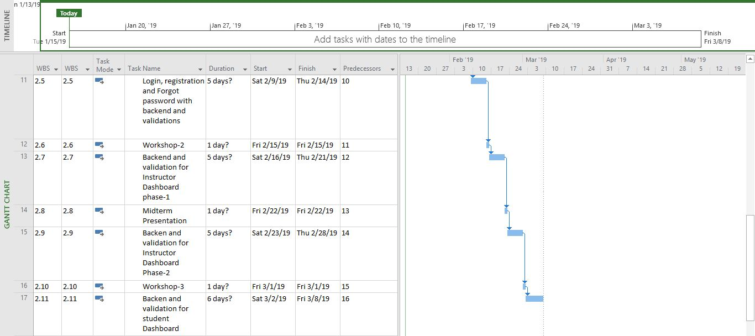
Gantt-Chart(cntd.)
Fig: Gantt-chart 2
Anurag Kumar
9

Slide 10
Future tasks
Creating student course functionality and adding validations on file upload and every forms
Complete the student dashboard
Creating Admin functionalities
Adding Security features such as login authentication
Performing selenium Testing on Web Application
Making application fully responsive to be work perfectly on IPhone SE/5
Chaithanya Cherukuru
10

Slide 11

Any Questions ?
Chaithanya Cherukuru
11

Slide 12

Chaithanya Cherukuru
12

